Slide 1
Berserker Gameflow
Presented by
8-bit Bacon

Slide 2
Actions
Attack:
The hero swings his sword in an arc in front of him when the attack button is pressed.
Why
Damage enemies
Manipulate environment
Generate Rage

Slide 3
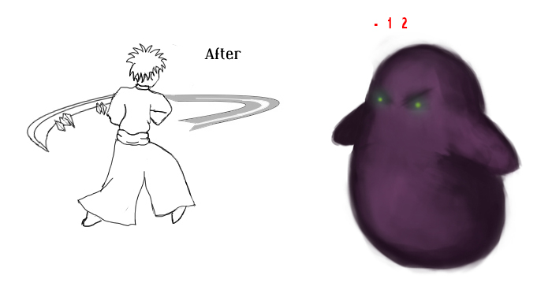
Attack
Damages enemies
Hits in an arc in front of the player.

Slide 4
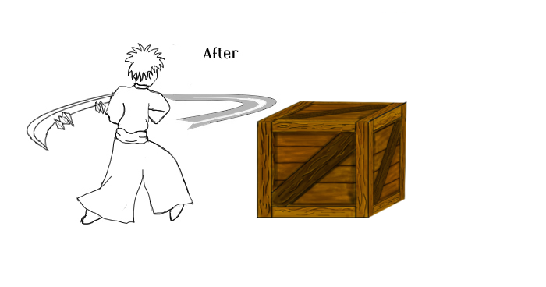
Attack
Manipulate environment
Break boxes for pickups
Flip levers

Slide 5
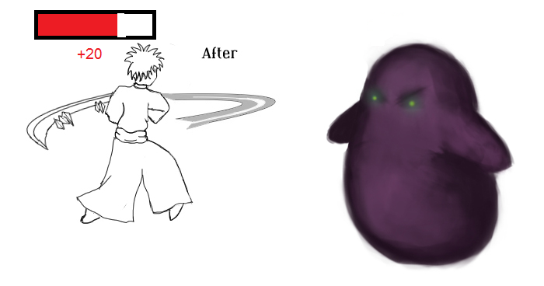
Attack
Generate Rage

Slide 6
Actions
Dash
The hero dashes in their current direction, avoiding attacks and knocking enemies back.
Why
Dodge attacks
Knock enemies back

Slide 7
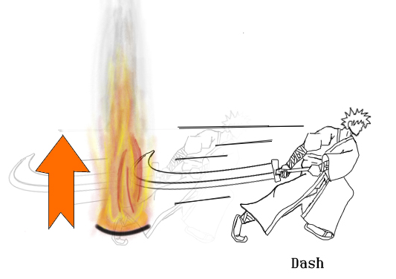
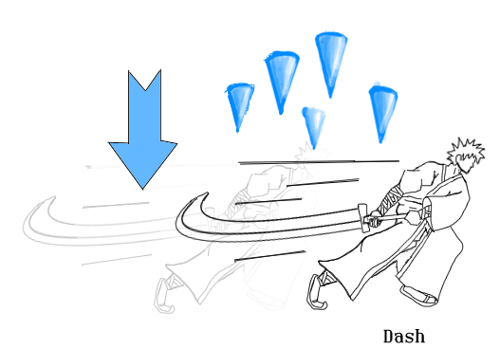
Dash
Dodge attacks

Slide 8
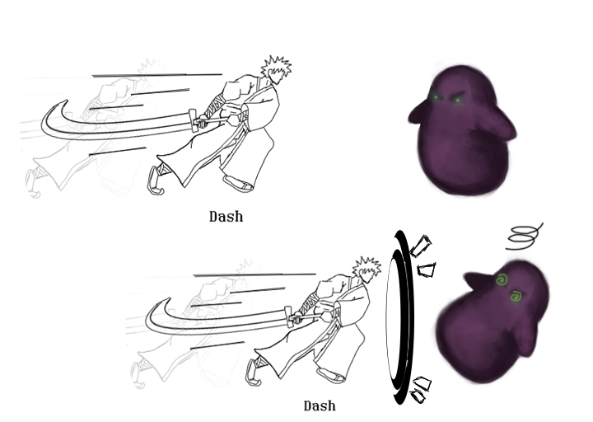
Dash
Push enemies back

Slide 9
Actions
Rage:
The hero powers his sword with fire or ice, and enhances his sword swing.
Why
Fire: Melt Ice
Fire: Set enemies on fire
Ice: Extinguish fire
Ice: Freeze enemies

Slide 10
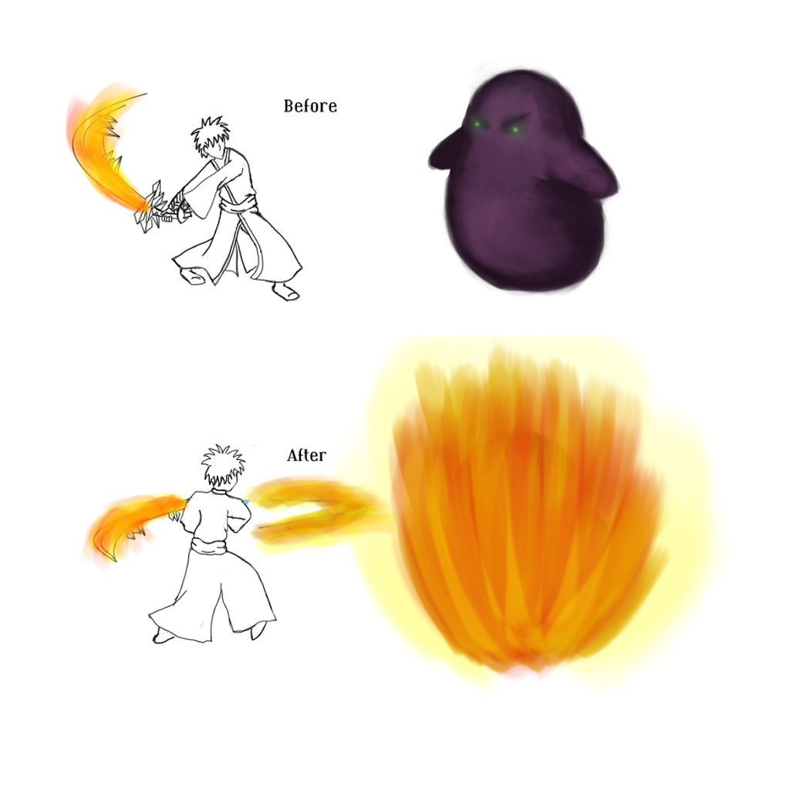
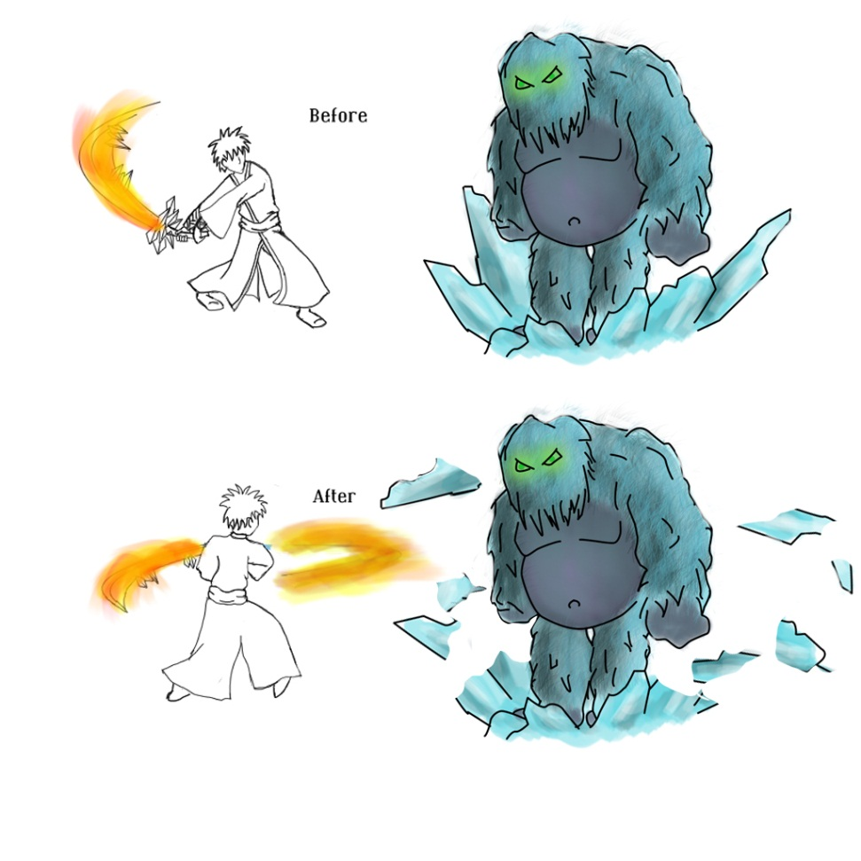
Rage
Fire: Melt ice, set enemies on fire

Slide 11
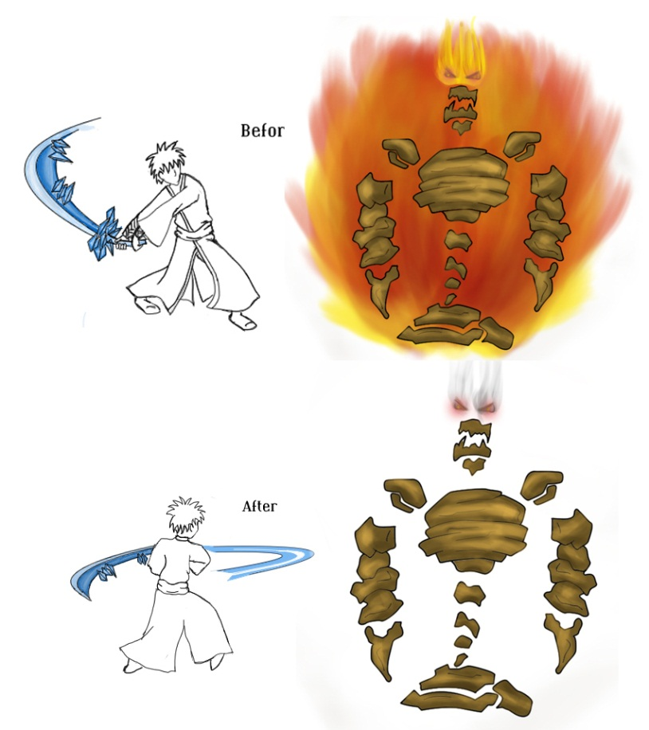
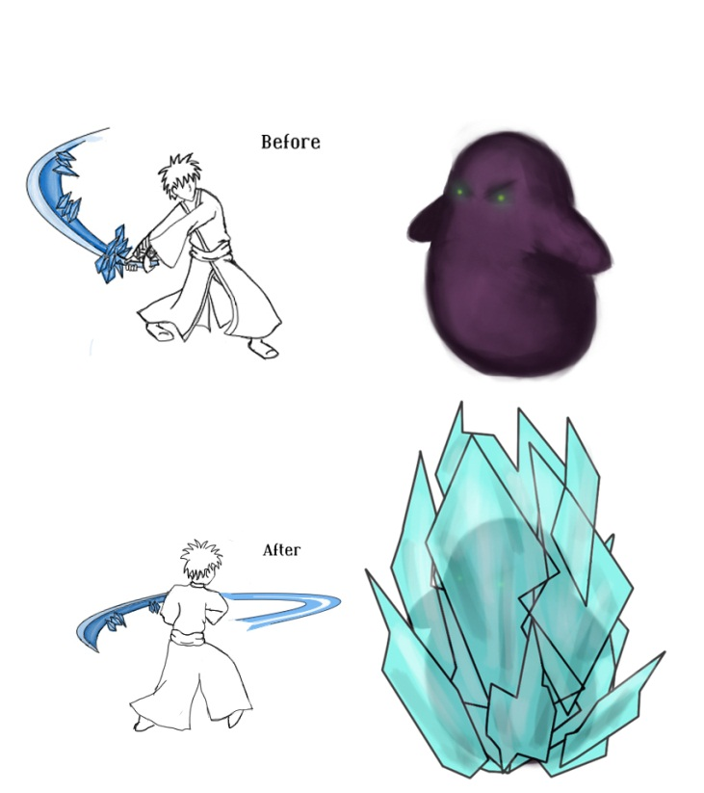
Rage
Ice: Extinguish fire, freeze enemies

Slide 12
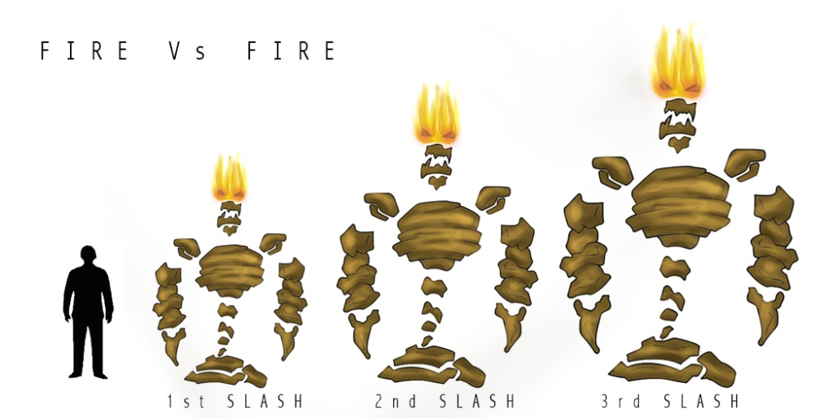
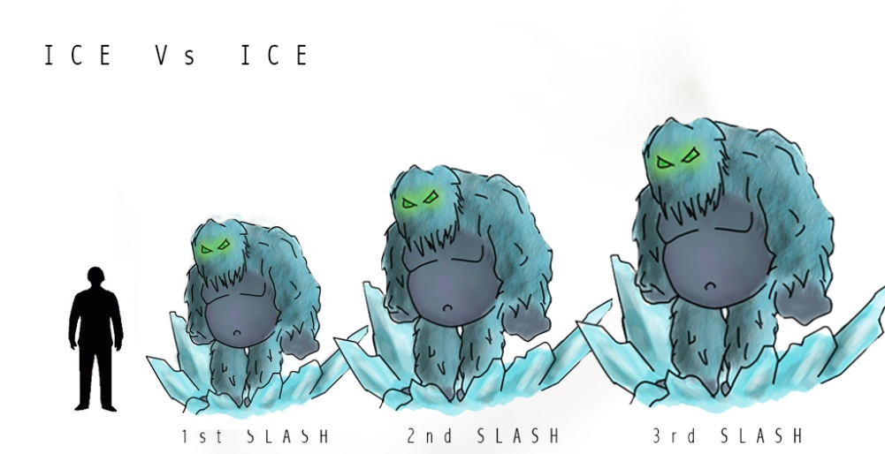

Rage
Incorrect usage of rage can lead to consequences…

Slide 13
Challenge Pieces
Enemies
Melee Minion
Ranged Minion
Explosive Minion
Ice Beast
Fire Beast
Pickups

Slide 14
Enemies
Melee Minion
Attack Range: 1 unit
Movement Speed: 2 units per second
Life: 3 hits to kill
Notable Actions: Swarming
Tell: Rears back before striking.

Slide 15
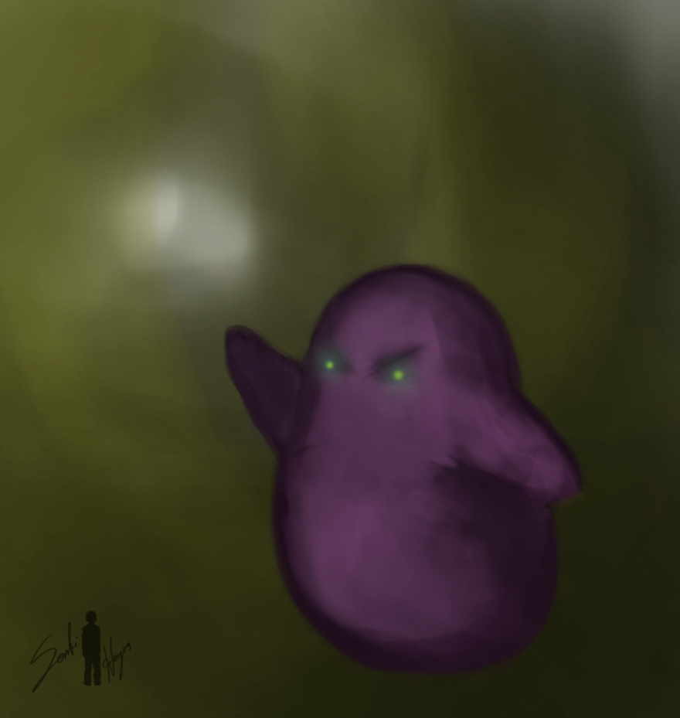
Melee Minion

Slide 16
Enemies
Ranged Minion
Attack Range: 10 units
Movement Speed: 4 units per second
Life: 2 hits to kill, 1 deflected orb
Notable Actions: Interrupting player action
Tell: Raises staff arm, then points it at the player.

Slide 17
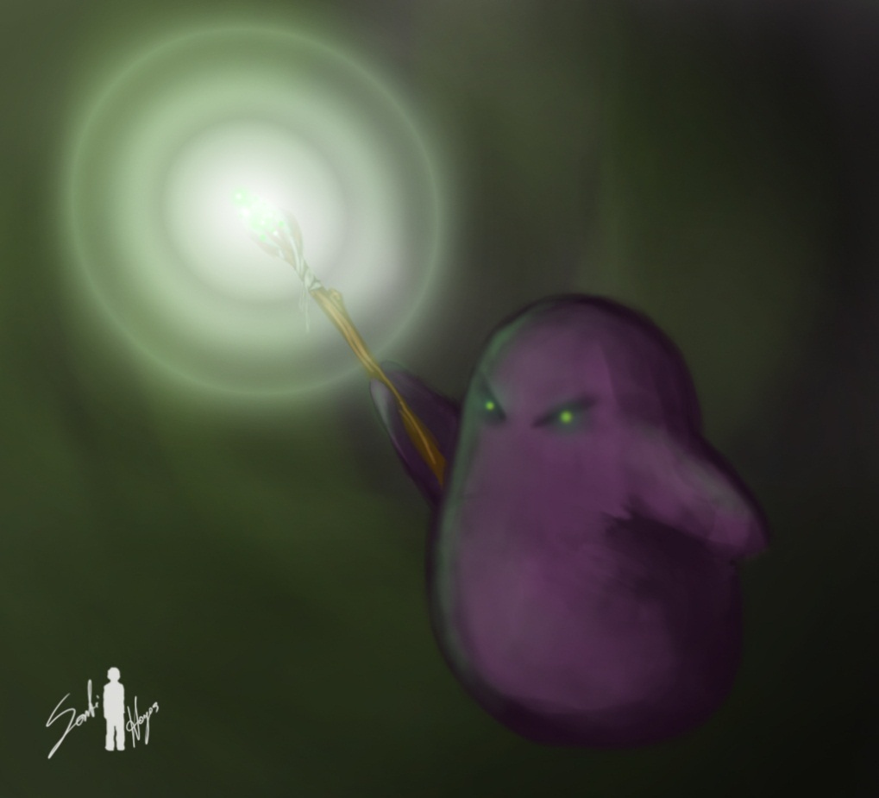
Ranged Minion

Slide 18
Enemies
Explosive minion
Attack Range: 2 units
Movement Speed: 5 units per second
Life: 4 hits to kill
Notable Actions: Causing massive damage to the player.
Tell: Lights bomb on back, then charges.

Slide 19
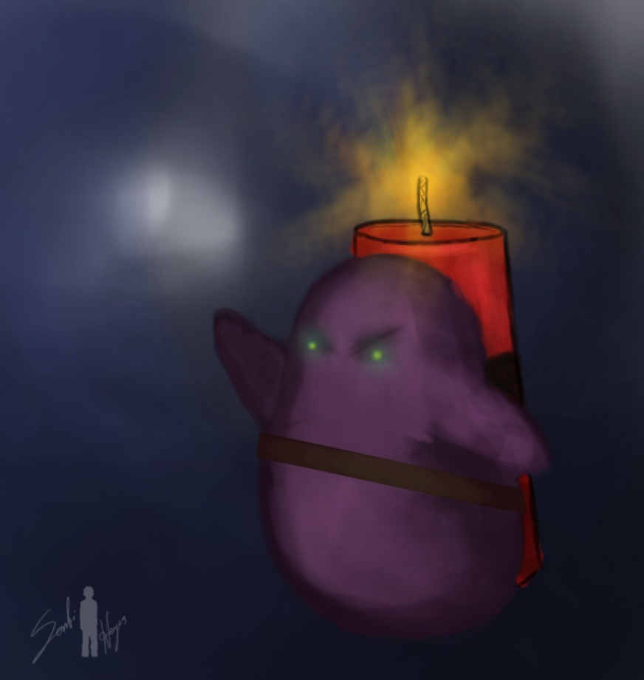
Explosive Minion

Slide 20
Enemies
Ice Beast
Attack Range: 8 units Snowballs, 2 units Punch
Movement Speed: 1 unit per second
Life: 10 hits to kill
Notable Actions: Harasses player from afar, then attacks when player breaks barrier.
Tell: Snowball: Digs hands into the ground, then flings a snowball high into the air. Punch: Raises arm into the air.

Slide 21
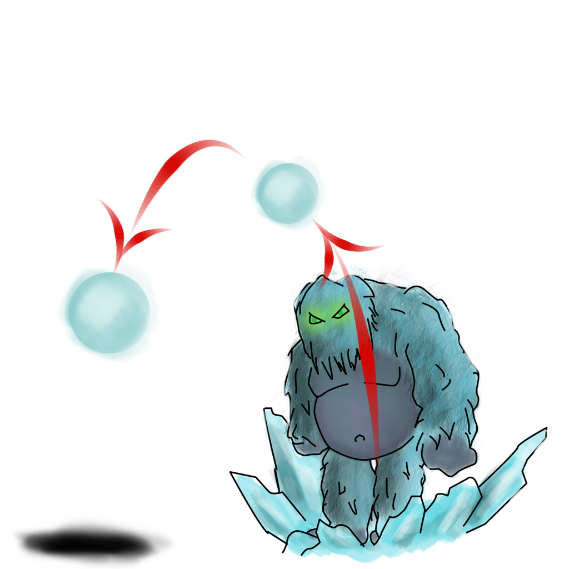
Ice Beast

Slide 22
Enemies
Magma Beast
Attack Range: Line in front of magma beast
Movement Speed: 6 units rolling, 2 units while slowed
Life: 10 hits to kill
Notable Actions: Rolls at the player, attempting to set the player on fire.
Tell: Curls into a ball.

Slide 23
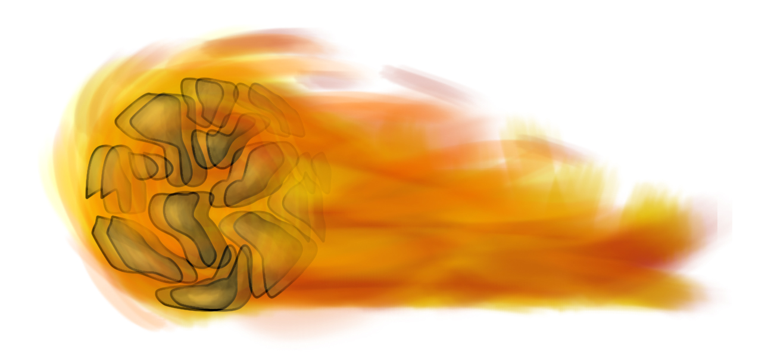
Magma Beast

Slide 24
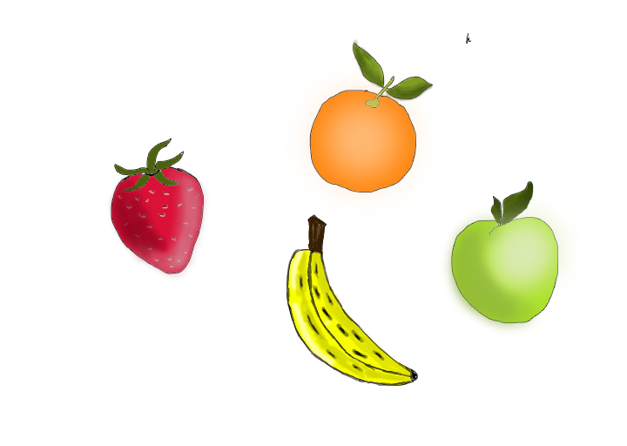

Pickups
Fruit – Restores the player’s health.
Bacon – Grants the player temporary infinite rage.

Slide 25
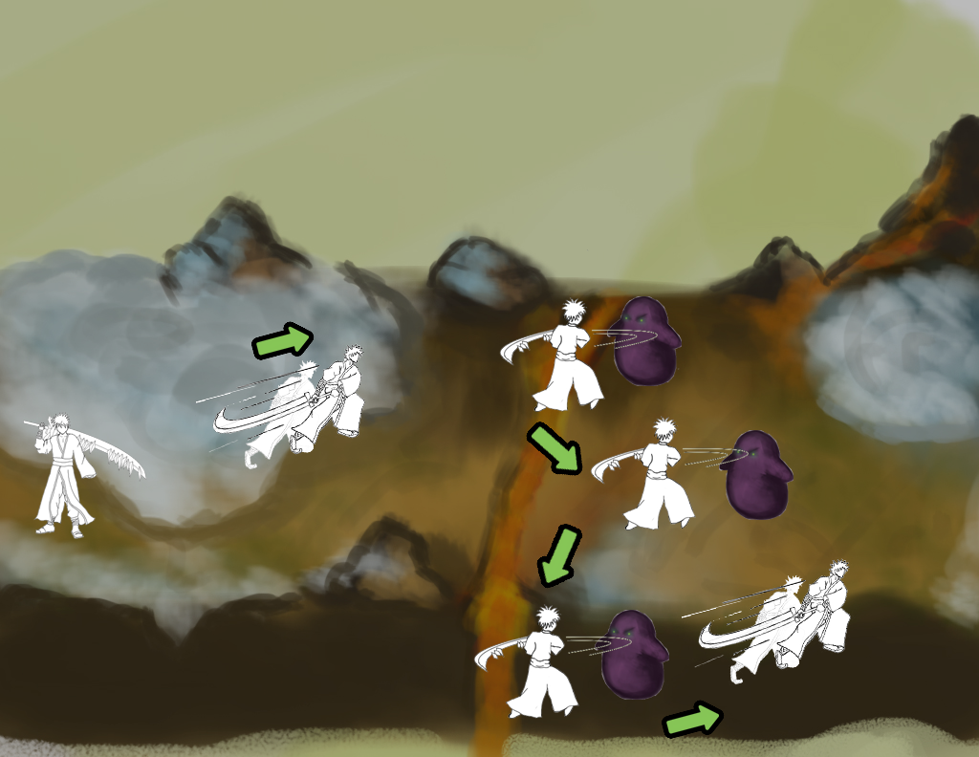
1
1. Player dashes and closes distance to melee minions
2. Player attacks melee minions

Slide 26
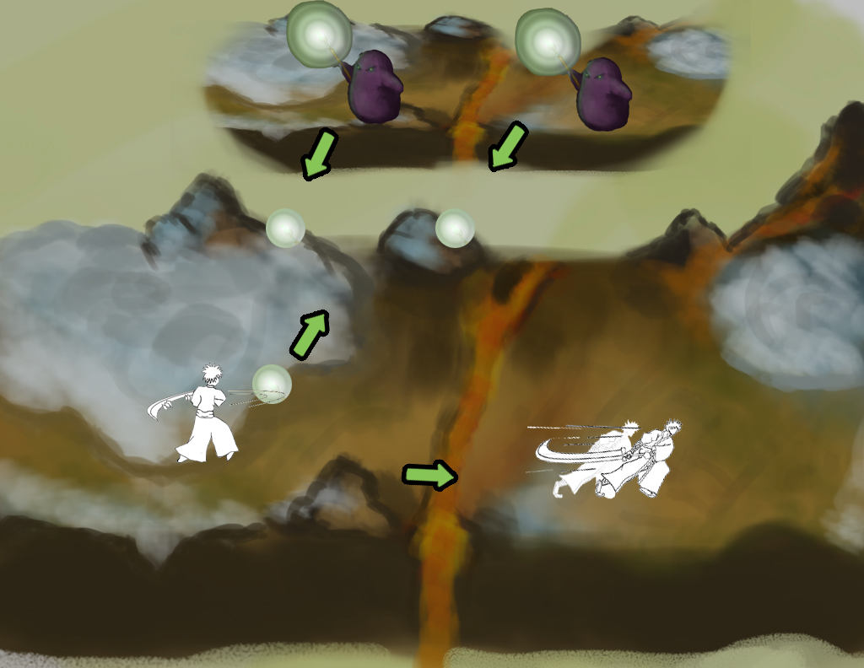
2
1. Player deflects orbs from both ranged minions and continues

Slide 27
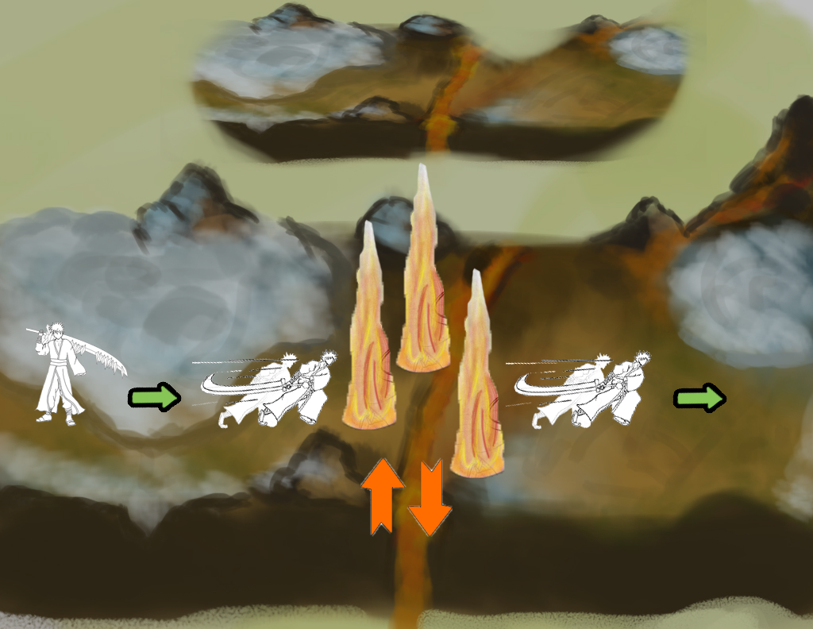
3
1. Player dashes past the lava plume and continues onward

Slide 28
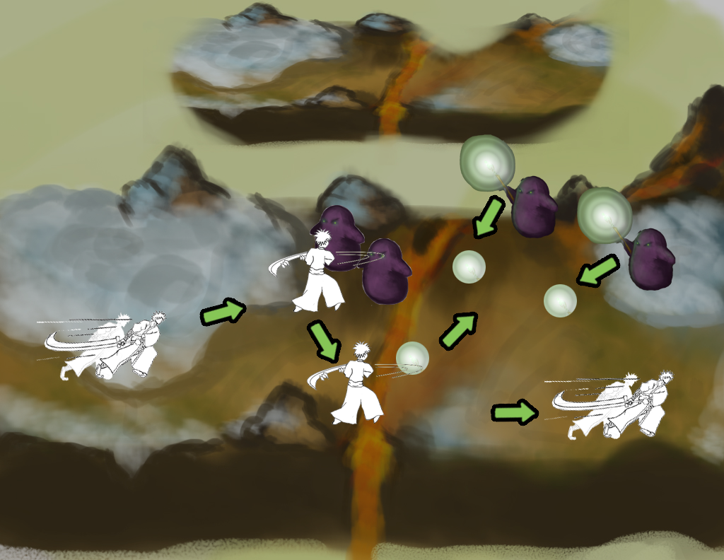
4
1. Player dashes and closes distance to melee minions
2. Player attacks the melee minions
3. Player deflects the orbs from the ranged minions

Slide 29
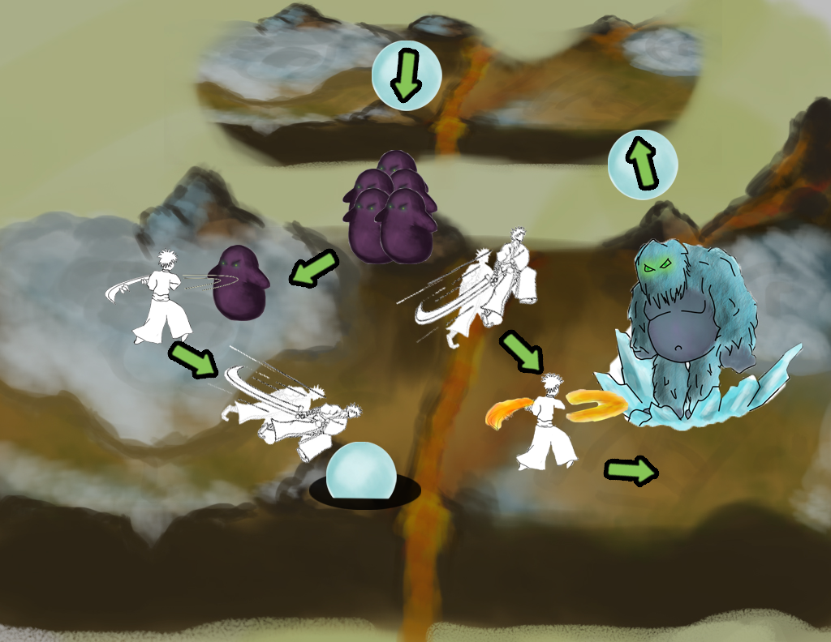
5
1. Player attacks continuously spawning melee minions to build rage
2. Player dashes to avoid snowballs hurled by the Ice Beast
3. Player uses Fire Rage to melt the ice barrier around the Ice Beast
4. Player attacks the Ice Beast

Slide 30
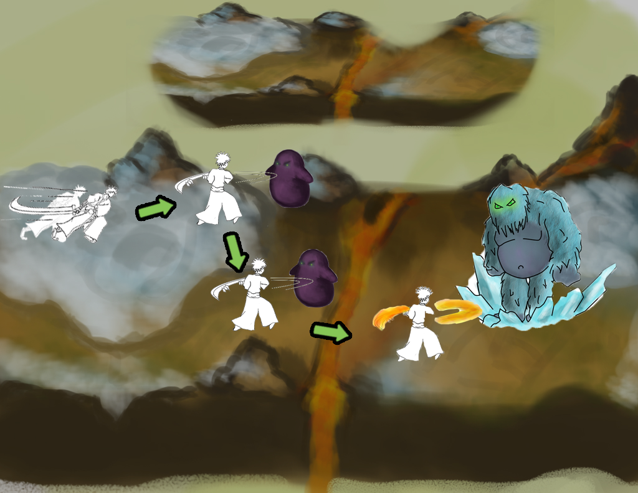
6
1. Player dashes to close distance to melee minions
2. Player attacks melee minions to build rage
3. Player uses Fire Rage to melt the ice barrier around the Ice Beast
4. Player attacks the Ice Beast

Slide 31
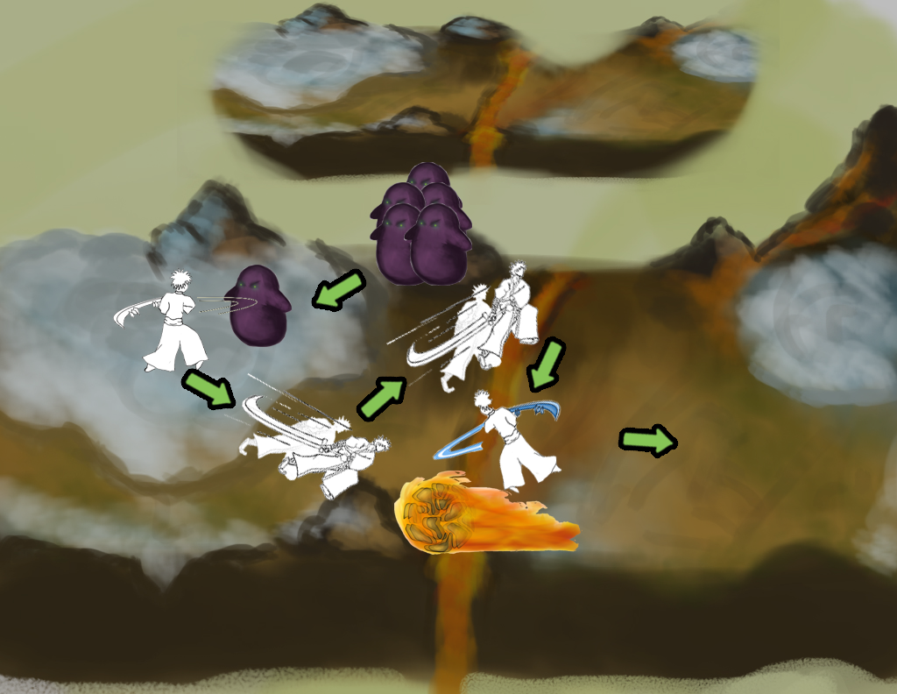
7
1. Player attacks continuously spawning melee minions to build rage
2. Player dashes to avoid the rolling Fire Beast
3. Player uses Ice Rage to extinguish the flames on the Fire Beast
4. Player attacks the Fire Beast

Slide 32
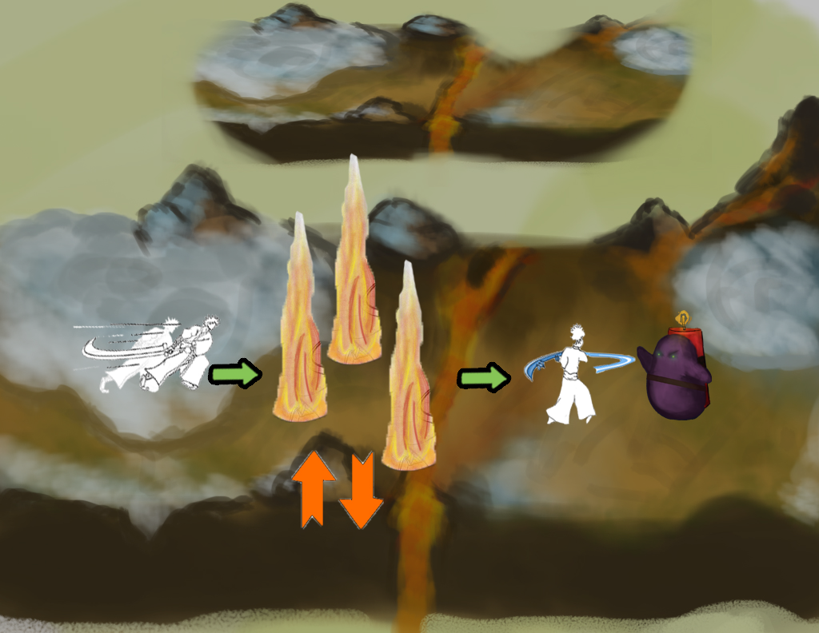
8
1. Player dashes past the lava plume
2. Player approaches the explosive minion
3. Player uses Ice Rage to extinguish the explosive on the minion’s back
4. Player attacks the explosive minion

Slide 33
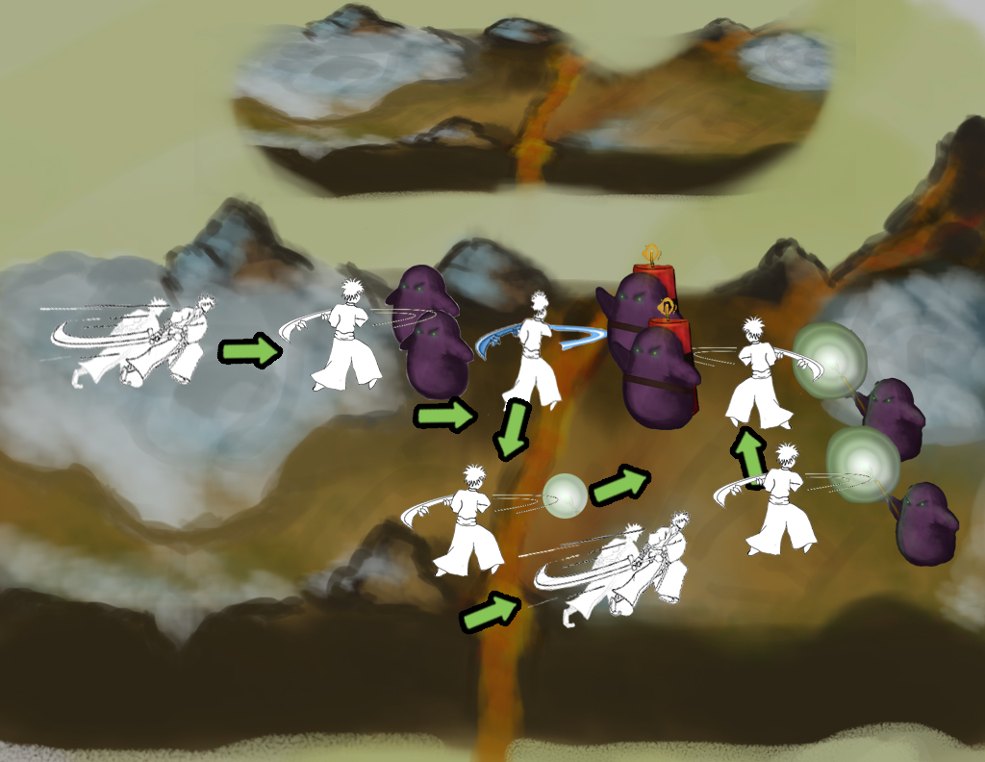
9
1. Player dashes to close in on the melee minions
2. Player attacks the melee minions
3. Player uses Ice Rage to extinguish the explosive on the minion’s backs
4. Player deflects orbs of ranged minions
5. Player dashes towards the ranged minions
6. Player attacks ranged minions
7. Player attacks explosive minions

Slide 34
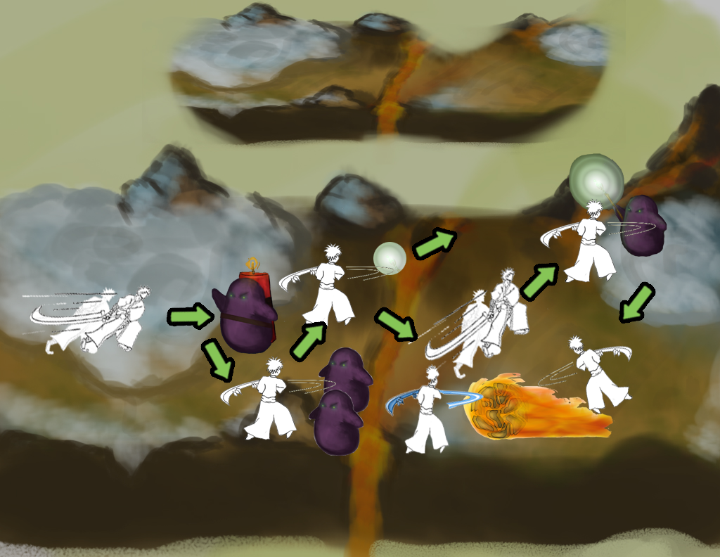
10
1. Player moves forward
2. Player dashes into the explosive minion
3. Player attacks melee minions
4. Player deflects orbs of ranged minion
5. Player uses Ice Rage to extinguish the flames on the Fire Beast
6. Player dashes to ranged minion
7. Player attacks ranged minion
8. Player attacks Fire Beast

Slide 35
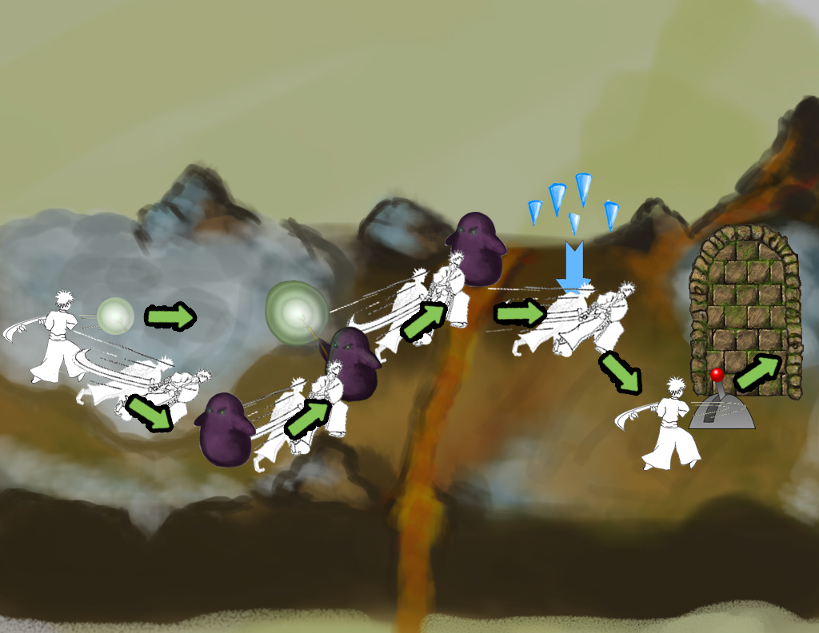
11
1. Player deflects ranged minion's orb, stunning him
2. Player dashes to the first melee minion
3. Player attacks and kills the minion
4. Player dashes to the ranged minion
5. Player attacks and kills the minion
6. Player attacks and kills the other melee minion
7. Player dashes to avoid the icicles
8. Player pulls lever that opens the door

Slide 36
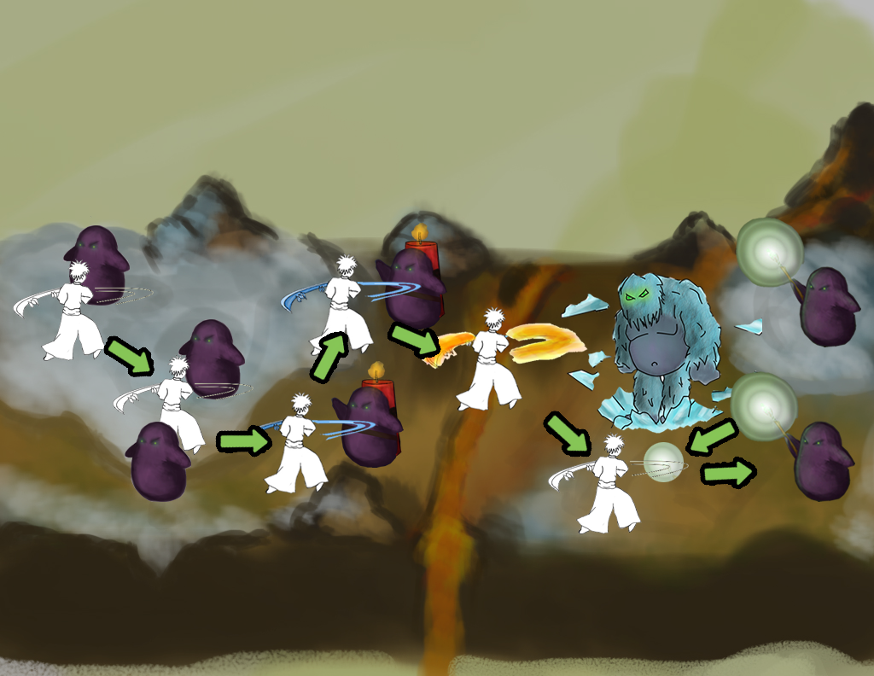
12
1. Player dashes to get between the minions
2. After the explosive minions light their bombs, player dashes into them
3. Both explosive minions explode near the ranged minions, killing them
4. Player kills the melee minions and build up rage
5. Player dashes to avoid the Ice Beast's attack
6. Player uses Fire Rage to break the Ice Beast's ice protection
7. Player uses Fire Rage to kill the Ice Beast

Slide 37
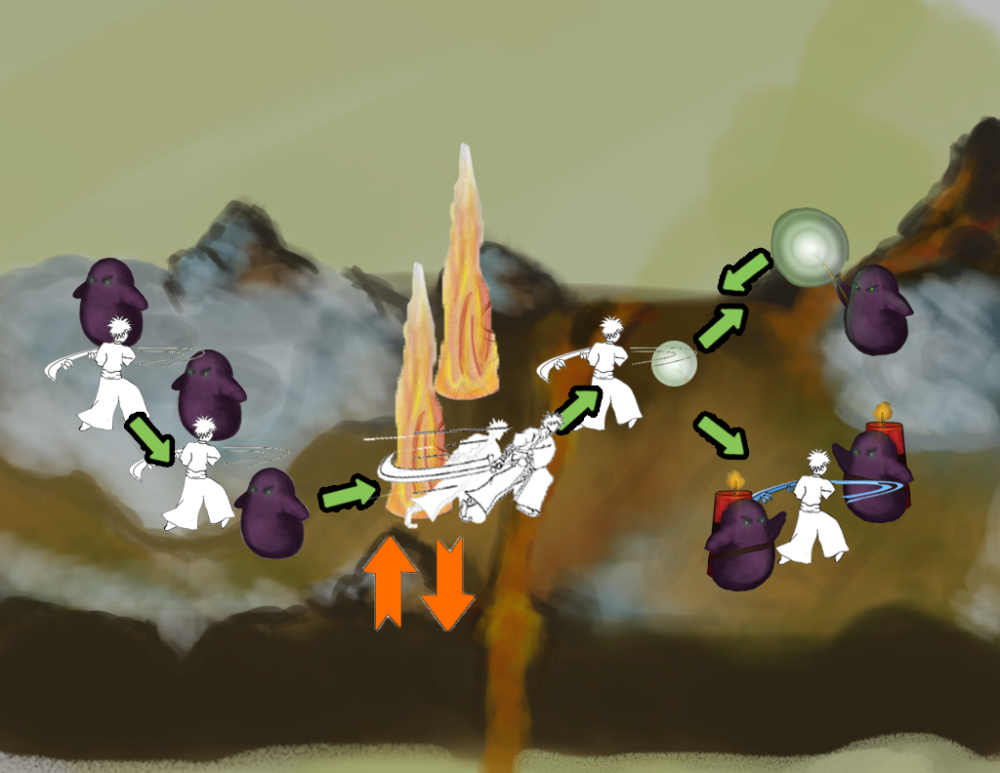
13
1. Player attacks and kills nearby melee minions
2. Player dashes to avoid lava plumes
3. Player deflects the ranged minion's orb, stunning him
4. Player uses Ice Rage to extinguish explosive minions' bombs if they're lit
5. Player attacks and kills explosive minions
6. Player attacks and kills ranged minion

Slide 38
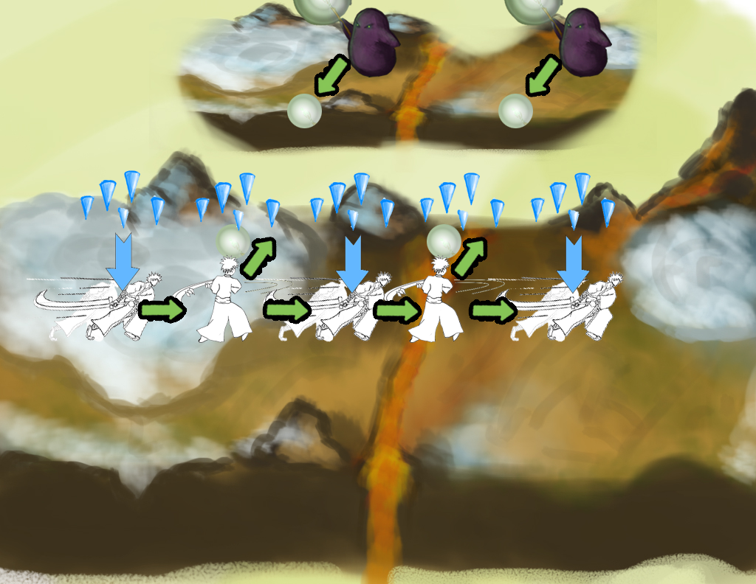
14
1. Player dashes to avoid icicles
2. Player attacks to deflect ranged minions' orbs, killing them
3. Player dashes to avoid icicles

Slide 39
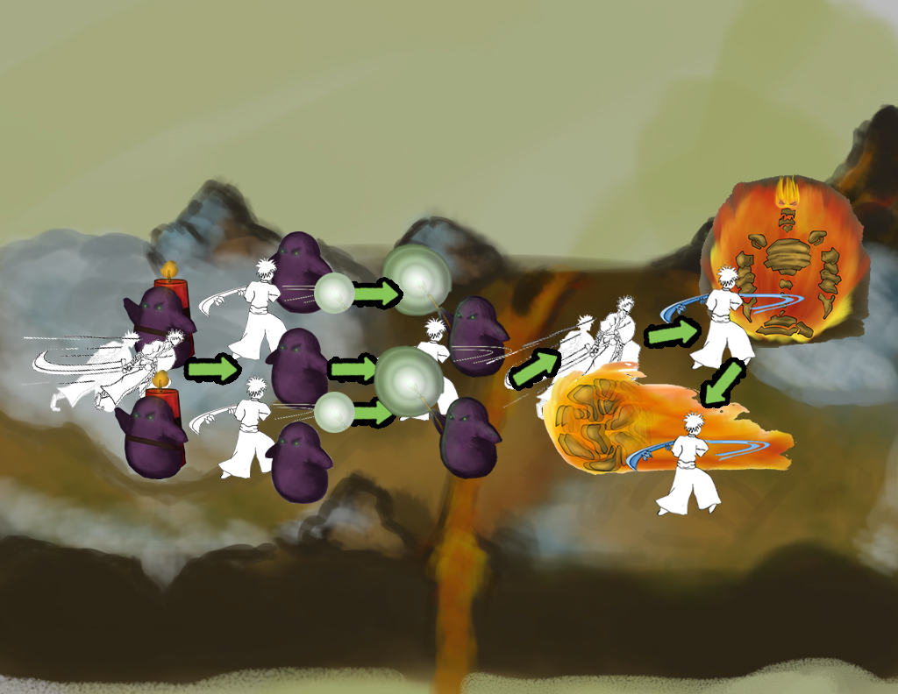
15
1. Player dashes into the explosive minions to knock them away
2. Player deflects the ranged minon's orb
3. Player attacks and kills the melee minions
4. Player dashes to avoid the rolling Fire Beasts
5. Player attacks and kills the ranged minion
6. Player dashes to avoid the rolling Fire Beasts
7. Player uses Ice Rage to extinguish explosive minions' bombs if they're lit
8. Player uses Ice Rage to extinguish the flames on the Fire Beasts
9. Player attacks and kills the explosive minions

Slide 40
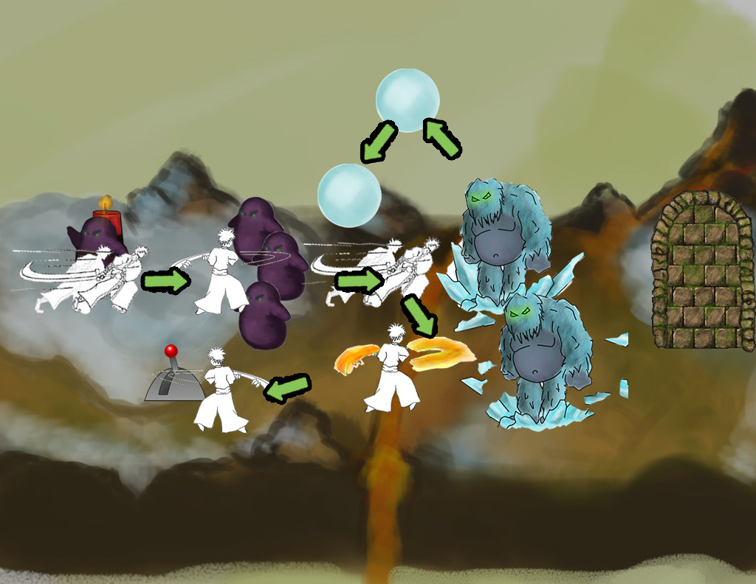
16
Player dashes away from the explosive minion.
Player attacks the regular minions.
Player dashes away from the Ice Beasts’ snowballs.
Player uses fire rage against the Ice Beasts’ ice barriers
Player attacks the Ice Beast
Player hits lever and moves to next area.

Slide 41
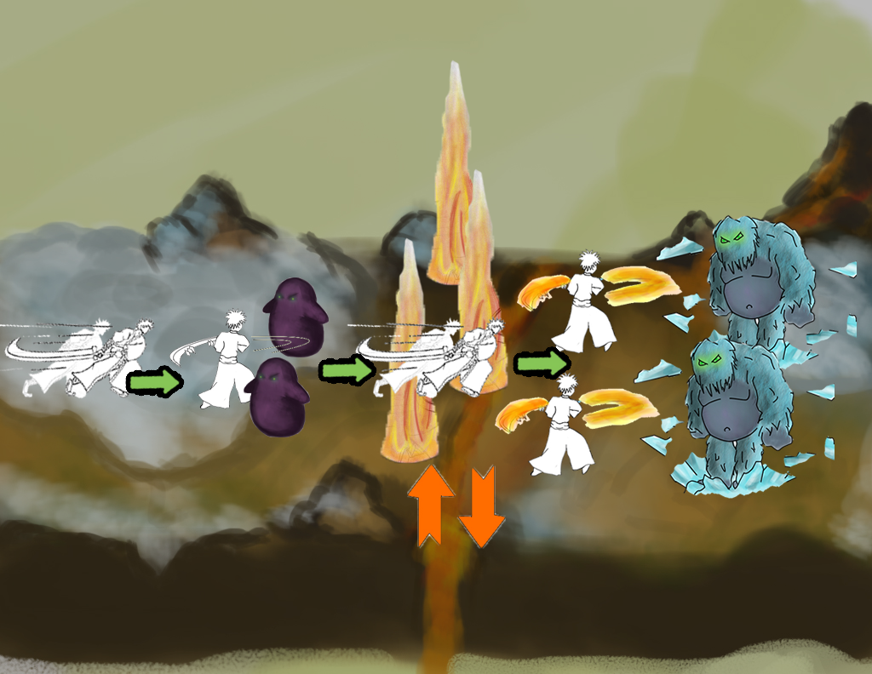
17
Player attacks the regular minions.
Player dashes through the traps when it is safe.
Player dashes away from the Ice Beasts’ snowballs.
Player uses fire rage against the Ice Beasts’ ice barriers
Player attacks the Ice Beasts
Player moves to next area

Slide 42
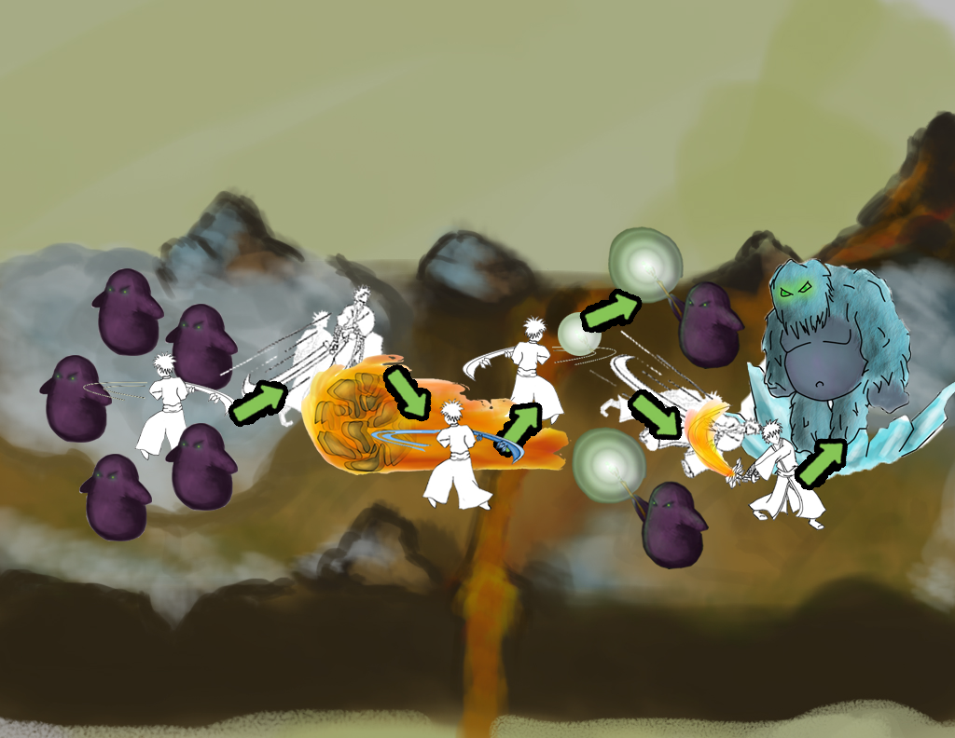
18
Player attacks the regular minions.
Player dodges magma beast’s roll attack.
Player uses ice rage to put out the magma beast.
Player attacks magma beast.
Player deflects the ranged minions’ attacks.
Player dashes away from the Ice Beasts’ snowballs.
Player uses fire rage against the Ice Beasts’ ice barriers
Player attacks the Ice Beasts.
Player moves to next area.

Slide 43
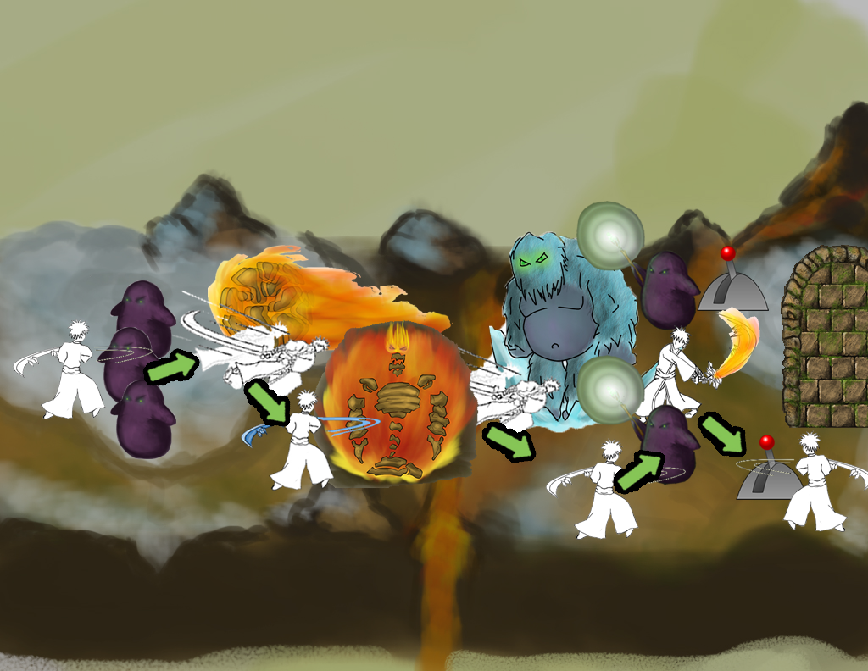
19
Player attacks regular minions.
Player dodges magma beast’s roll attack.
Player uses ice rage to put out the magma beast.
Player attacks magma beast.
Player dashes away from the Ice Beasts’ snowballs.
Player uses fire rage against the Ice Beasts’ ice barriers
Player attacks the Ice Beasts.
Player activates the leavers in the right order.
Player moves on to the next level.

Slide 44
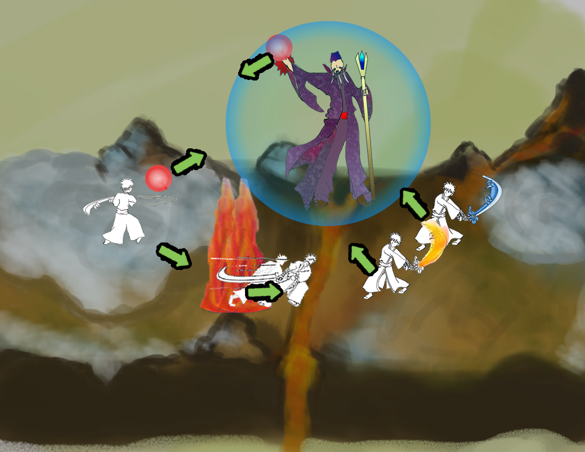
20
Player deflects orbs back at the wizard (3 times).
Player attacks any minions.
Player attacks wizard.
Player dodges wizard’s lava attack.
Player throws bomb at wizard to stun (3 times).
Player uses fire rage against wizard.
Player uses ice rage against wizard.
Player defeats wizard.

